Slide 1

ACNet-based MobileNet for image classification
158.750 Information Sciences Research Methods
Name：Tao Jiang Student ID：20004769

Slide 2

CONTENTS
1
Background
2
Motivation
3
Method
ACNet-based MobileNet
ACNet-based GhostNet
4
Experiments
5
Conclusion

Slide 3
1 Background
AlexNet, VGGNet, GoogLeNet, ResNet are deep and huge Neural Networks. They are challenging to apply to real life, only staying in the laboratory stage.
Huge
network size
MobileNet uses technologies such as an inverted residual network to reduce parameters and network size. However, It has a side effect of decreasing accuracy.
Image
Classification
Slight model
Insufficient Accuracy
MLP（multilayer perceptron） focus on global inference,
and CNN（convolutional neural network） focus on local inference.
CNN & MLP limitations

Slide 4
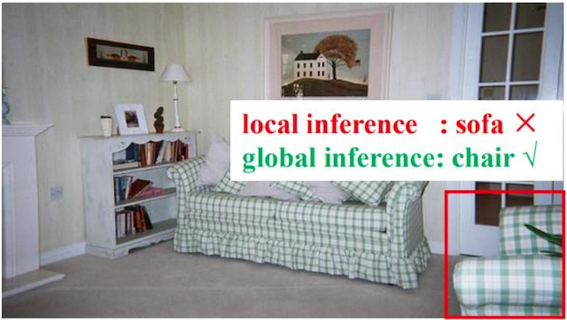

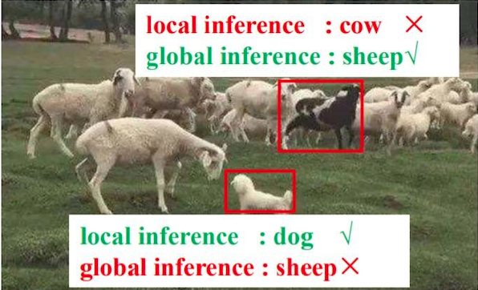
2 Motivation
CNNs
local inference
MLP
global inference

Slide 5
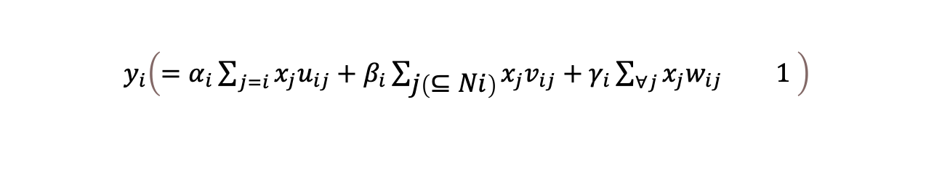
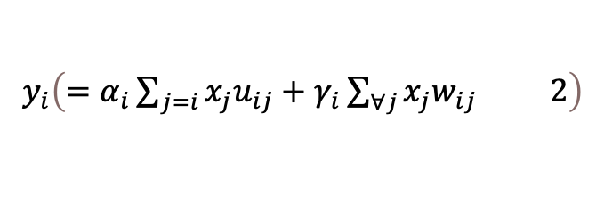
3 Method
Self transformation
Local inference
Global inference
ACNet
$$\left.y_{i} ( =α_{i}\sum_{j=i}{x_{j}u_{ij}}+β_{i}\sum_{\left.j ( ⊆Ni\right)}{x_{j}v_{ij}}+γ_{i}\sum_{∀j}{x_{j}w_{ij}} 1 \right)$$
$$\left.y_{i} ( =α_{i}\sum_{j=i}{x_{j}u_{ij}}+γ_{i}\sum_{∀j}{x_{j}w_{ij}} 2\right)$$
The traditional 1*1 convolution operation uses formula 2 to global inference and self transformation.

Slide 6
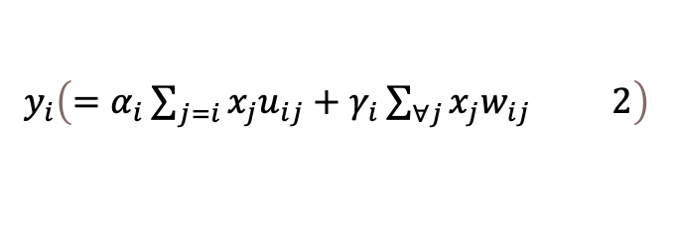
3 Method
ACNet-based MobileNet
$$\left.y_{i} ( =α_{i}\sum_{j=i}{x_{j}u_{ij}}+γ_{i}\sum_{∀j}{x_{j}w_{ij}} 2\right)$$
Using global inference and self transformation
Adaptively inverted residual

Slide 7
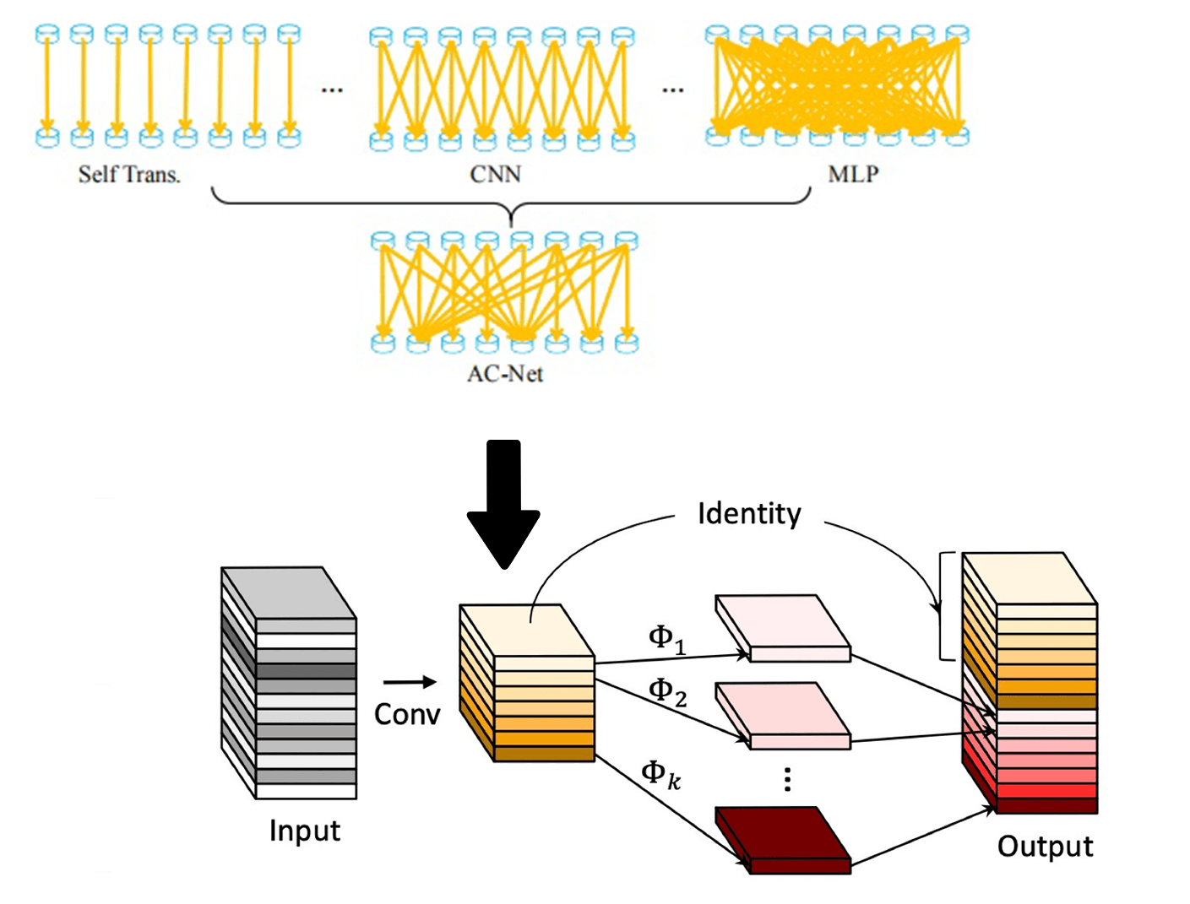
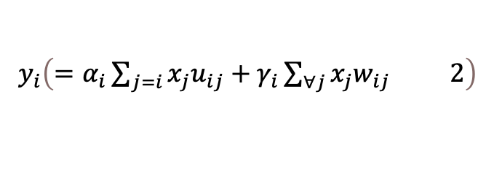
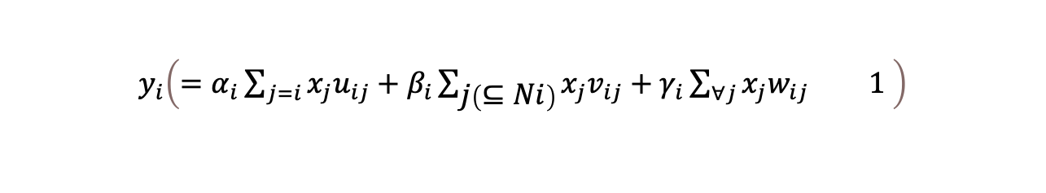
3 Method
ACNet-based GhostNet
$$\left.y_{i} ( =α_{i}\sum_{j=i}{x_{j}u_{ij}}+β_{i}\sum_{\left.j ( ⊆Ni\right)}{x_{j}v_{ij}}+γ_{i}\sum_{∀j}{x_{j}w_{ij}} 1 \right)$$
Using global inference, local inference and self-transformation
Adaptive Ghost module
$$\left.y_{i} ( =α_{i}\sum_{j=i}{x_{j}u_{ij}}+γ_{i}\sum_{∀j}{x_{j}w_{ij}} 2\right)$$

Slide 8
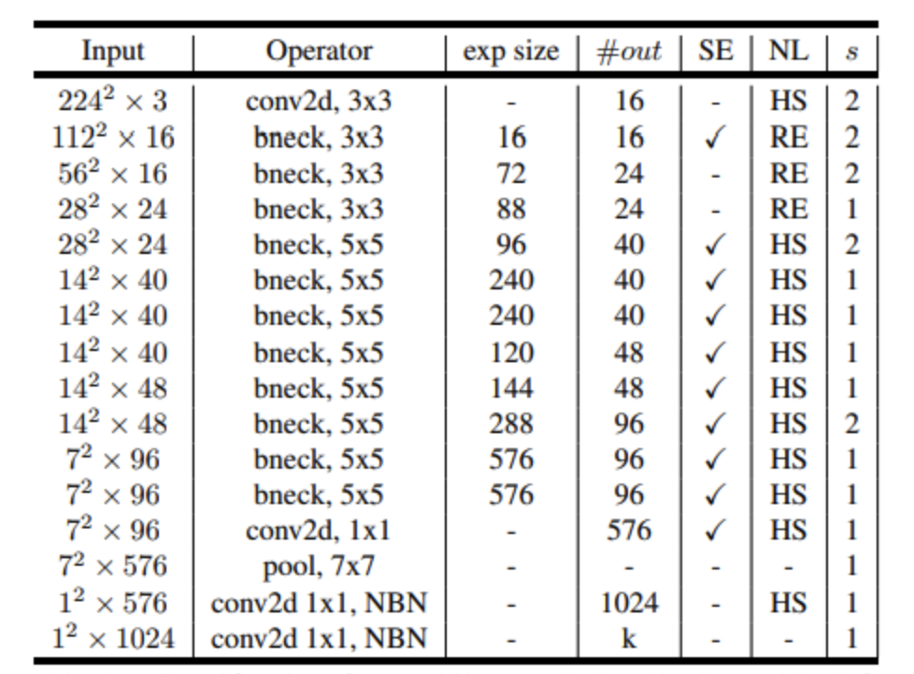
4 Experiments
Cifar-100
100 classes
50000 training images
10000 testing images
specification for mebilenet v3 -small

Slide 9
4 Experiments
 | acc1 | acc5 | Epoch | Training Time
MobileNetV3(SMALL) | 66.75 | 89.79 | 100 | 2h35min
ACNet-based MobileNet | 67.67 | 90.17 | 100 | 3h10min
 | acc1 | acc5 | Epoch | Training Time
GhostNet | 68.49 | 90.83 | 100 | 4h0min
ACNet-based GhostNet | 69.18 | 90.89 | 100 | 5h20min

Slide 10
5 Conclusion
Hyperparameter searching, such as learning rate is set too small
Inverted residual loss of two-dimensional information. It cannot be compensated by simple global inference.

Slide 11
Reference
A. Howard et al., “Searching for mobileNetV3,” Proc. IEEE Int. Conf. Comput. Vis., vol. 2019-Octob, pp. 1314–1324, 2019, doi: 10.1109/ICCV.2019.00140.
G. Wang, K. Wang, and L. Lin, “Adaptively connected neural networks,” Proc. IEEE Comput. Soc. Conf. Comput. Vis. Pattern Recognit., vol. 2019-June, pp. 1781–1790, 2019, doi: 10.1109/CVPR.2019.00188.
A. G. Howard and W. Wang, “MobileNets: Efficient Convolutional Neural Networks for Mobile Vision Applications,” 2012.
K. He, X. Zhang, S. Ren, and J. Sun, “Deep residual learning for image recognition,” Proc. IEEE Comput. Soc. Conf. Comput. Vis. Pattern Recognit., vol. 2016-Decem, pp. 770–778, 2016, doi: 10.1109/CVPR.2016.90.
K. Simonyan and A. Zisserman, “Very deep convolutional networks for large-scale image recognition,” 3rd Int. Conf. Learn. Represent. ICLR 2015 - Conf. Track Proc., pp. 1–14, 2015.
Y. LeCun, L. Bottou, Y. Bengio, and P. Haffner, “Gradient-based learning applied to document recognition,” Proc. IEEE, vol. 86, no. 11, 1998, doi: 10.1109/5.726791.
A. Krizhevsky, I. Sutskever, and G. E. Hinton, “ImageNet classification with deep convolutional neural networks,” Commun. ACM, vol. 60, no. 6, pp. 84–90, 2017, doi: 10.1145/3065386.
C. Szegedy et al., “Going deeper with convolutions,” in Proceedings of the IEEE Computer Society Conference on Computer Vision and Pattern Recognition, 2015, vol. 07-12-June-2015, doi: 10.1109/CVPR.2015.7298594.
O. Russakovsky et al., “ImageNet Large Scale Visual Recognition Challenge,” Int. J. Comput. Vis., vol. 115, no. 3, pp. 211–252, 2015, doi: 10.1007/s11263-015-0816-y.
M. B. McCrary, “Urban multicultural trauma patients.,” ASHA, vol. 34, no. 4, 1992.
T. He, Z. Zhang, H. Zhang, Z. Zhang, J. Xie, and M. Li, “Bag of tricks for image classification with convolutional neural networks,” Proc. IEEE Comput. Soc. Conf. Comput. Vis. Pattern Recognit., vol. 2019-June, pp. 558–567, 2019, doi: 10.1109/CVPR.2019.00065.

Slide 12
Thanks

